Slide 1


Malignant Comments Classifier
Submitted By
RAJASEKAR

Slide 2
Acknowledgement :-
This project includes the professional reference of much external reference analysis done by the individuals. Such references are mentioned below,
1. Raushan Kumar
2. ArunKumar
These individuals professionals and their researches helped and guided me in completion of this project.

Slide 3
TABLE OF CONTENTS :-
PROBLEM STATEMENT
BUSINESS GOAL
DATA-SET DESCRIPTION
DATA PREPROCESSING
DATA CLEANING
DATA VISUALIZATION
FEATURE EXTRACTION
MODEL BUILDING

Slide 4
PROBLEM STATEMENT
The proliferation of social media enables people to express their opinions widely online. However, at the same time, this has resulted in the emergence of conflict and hate, making online environments uninviting for users. Although researchers have found that hate is a problem across multiple platforms, there is a lack of models for online hate detection.
Online hate, described as abusive language, aggression, cyberbullying, hatefulness and many others has been identified as a major threat on online social media platforms. Social media platforms are the most prominent grounds for such toxic behaviour.

Slide 5
There has been a remarkable increase in the cases of cyberbullying and trolls on various social media platforms. Many celebrities and influences are facing backlashes from people and have to come across hateful and offensive comments. This can take a toll on anyone and affect them mentally leading to depression, mental illness, self-hatred and suicidal thoughts.
Internet comments are bastions of hatred and vitriol. While online anonymity has provided a new outlet for aggression and hate speech, machine learning can be used to fight it. The problem we sought to solve was the tagging of internet comments that are aggressive towards other users. This means that insults to third parties such as celebrities will be tagged as unoffensive, but “u are an idiot” is clearly offensive.

Slide 6
BUSINESS GOAL
Our goal is to build a prototype of online hate and abuse comment classifier which can used to classify hate and offensive comments so that it can be controlled and restricted from spreading hatred and cyberbullying.
DATA-SET DESCRIPTIONS
The data set contains the training set, which has approximately 1,59,000 samples and the test set which contains nearly 1,53,000 samples. All the data samples contain 8 fields which includes ‘Id’, ‘Comments’, ‘Malignant’, ‘Highly malignant’, ‘Rude’, ‘Threat’, ‘Abuse’ and ‘Loathe’.

Slide 7
The data-set contains:-
Malignant: It is the Label column, which includes values 0 and 1, denoting if the comment is malignant or not.
Highly Malignant: It denotes comments that are highly malignant and hurtful.
Rude: It denotes comments that are very rude and offensive.
Threat: It contains indication of the comments that are giving any threat to someone.
Abuse: It is for comments that are abusive in nature.
Loathe: It describes the comments which are hateful and loathing in nature.
ID: It includes unique Ids associated with each comment text given.
Comment text: This column contains the comments extracted from various social media platforms.

Slide 8
ANALYTICAL PROBLEM FRAMING
1. What is Analytical problem framing :-
Analytic problem framing involves translating the business problem into terms that can be addressed analytically via data and modelling. It’s at this stage that you work backwards From the results / outputs you want to the data/inputs you’re going to need, where you identify potential drivers and,
hypotheses to test, and where you nail down your assumptions. Analytic problem framing is the antithesis of merely working with the ready-to-hand data and seeing what comes of it, hoping for something insightful. Typically, the process moves on from here to data collection, cleansing and transformation, Methodology selection and model building, never to return. But if you’re willing to borrow and use a concept from complex adaptive systems – maps and models – you can make repeat use of this stage to improve your overall outcome.

Slide 9
2. Hardware requirements:-
A mid level computer that runs on Intel i3/i5/i7 or A10/A11/M1 or ryzen 3/5 or any other equivalent chipset and a suitable processor.
3. Software requirements :-
Windows / Linux /Mac OS
4. TOOLS, Libraries and packages used :-
Tool: 1. Anaconda Navigator
2. Jupyter Notebook

Slide 10
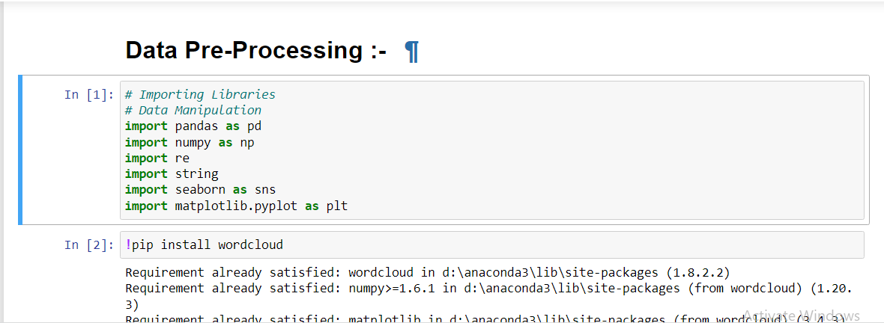
Libraries and Packages:
1. Numpy.
2. Pandas.
3. Matplotlib.
4. Seaborn.
5. DATA-PREPROCESSING :-

Slide 11
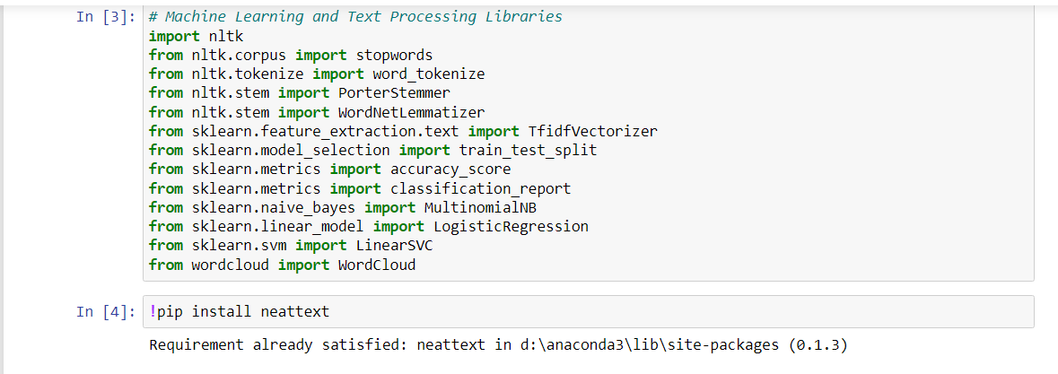
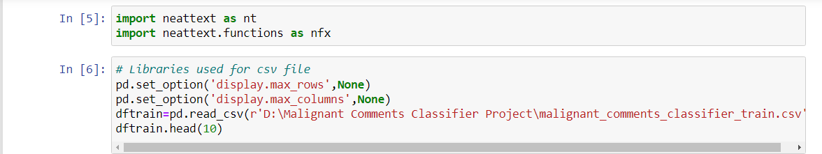

Slide 12
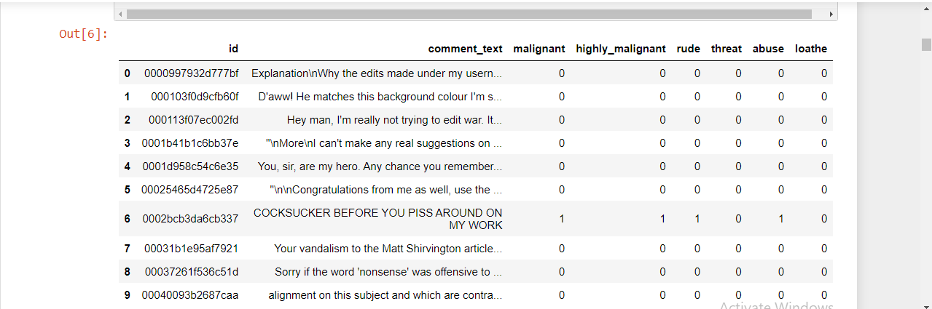
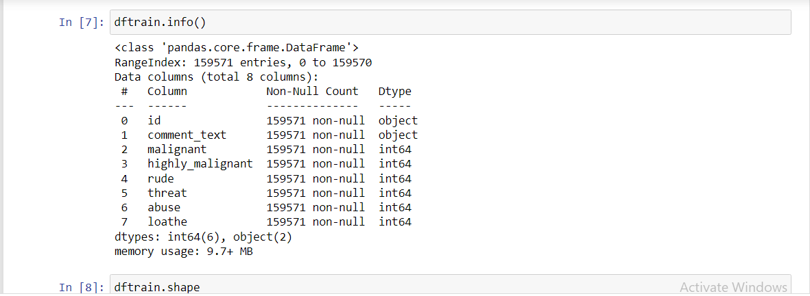

Slide 13
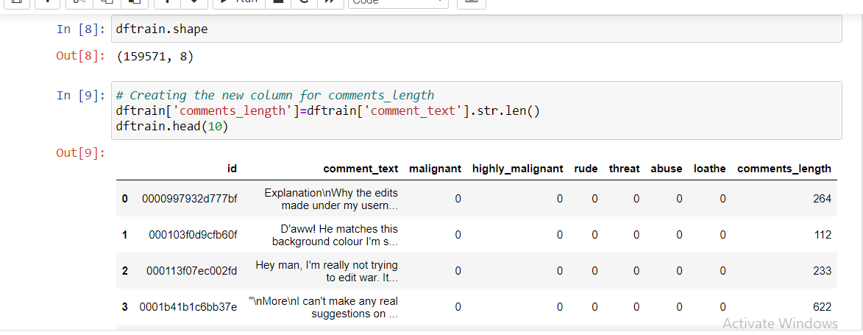
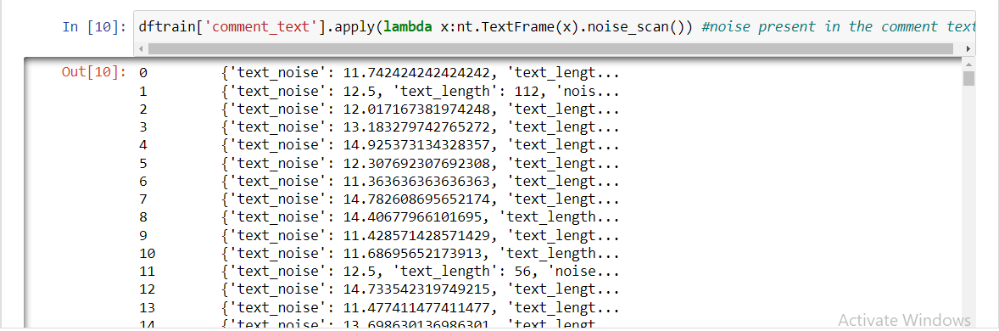

Slide 14
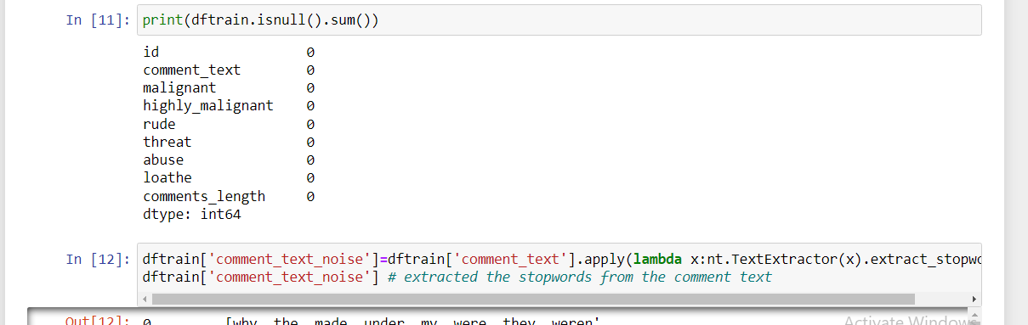
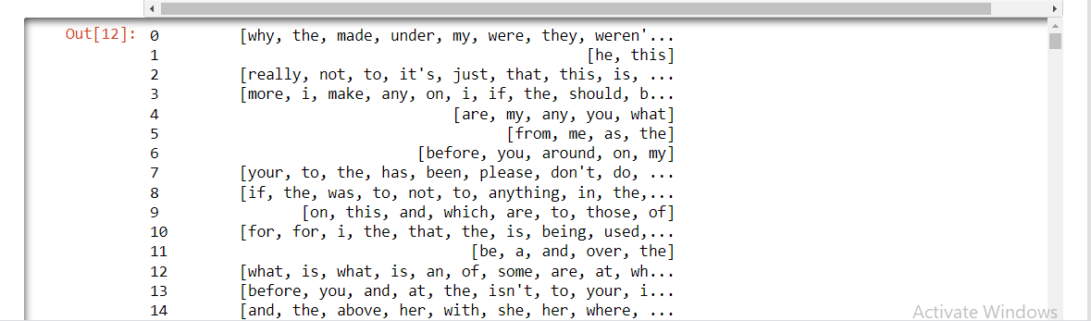

Slide 15
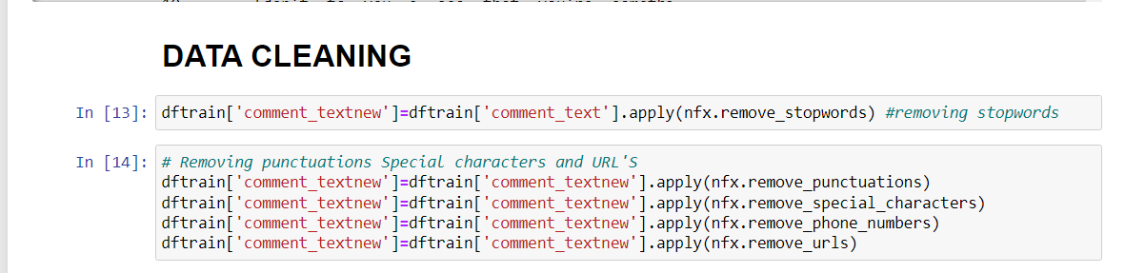
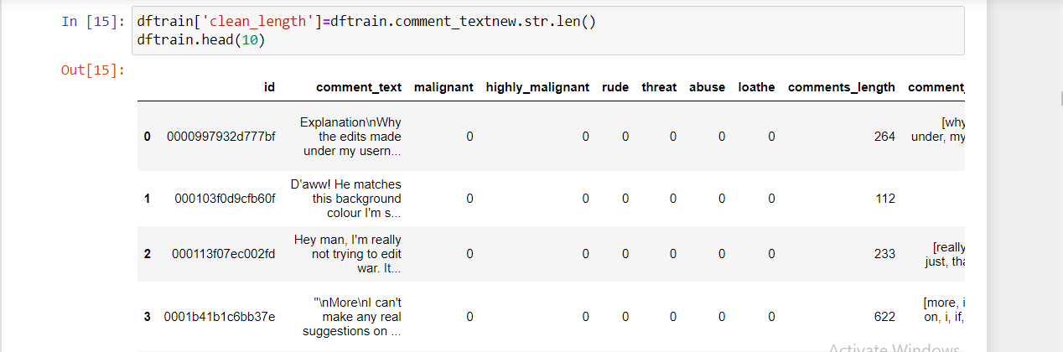

Slide 16
OBSERVATIONS :-
We could see that data has been cleaned and is ready to build a ML model. But before that let’s sense the word traffic in the given data-set.
This helps in understanding the dataset and also helps us in choosing.

Slide 17
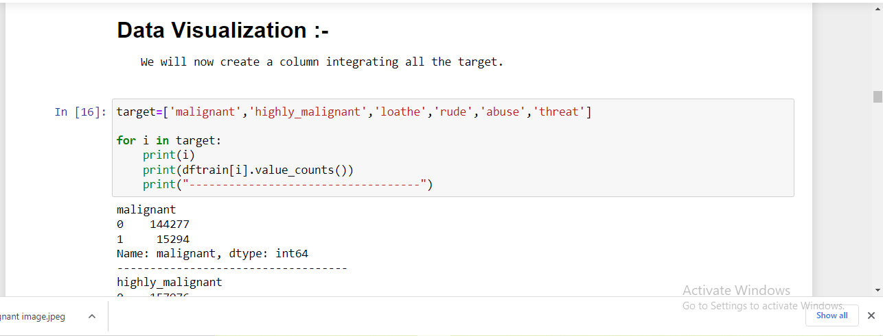
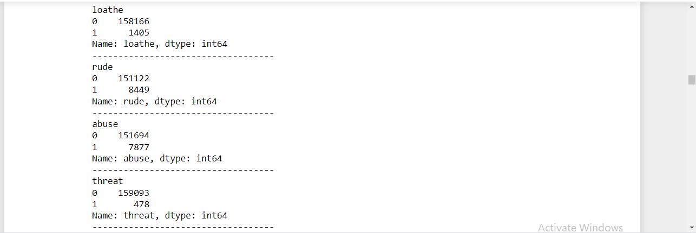
DATA – VISUALIZATION :-

Slide 18
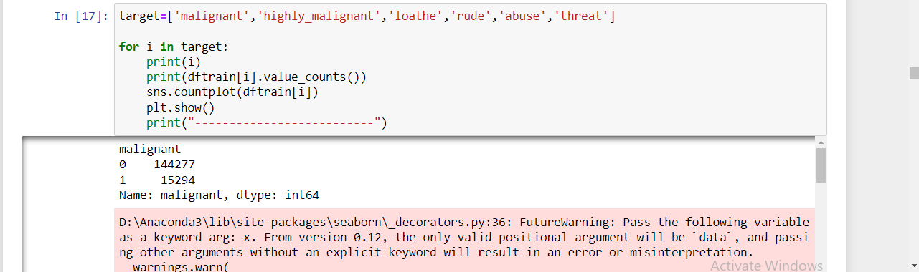
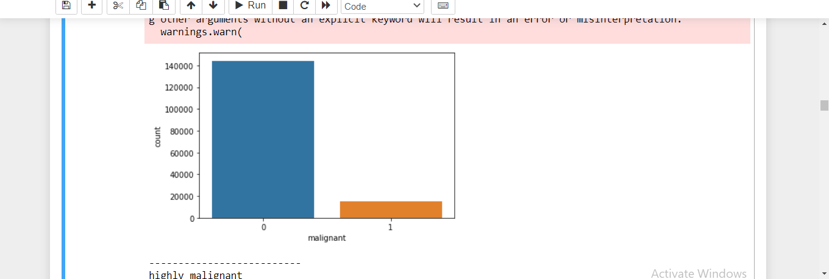

Slide 19
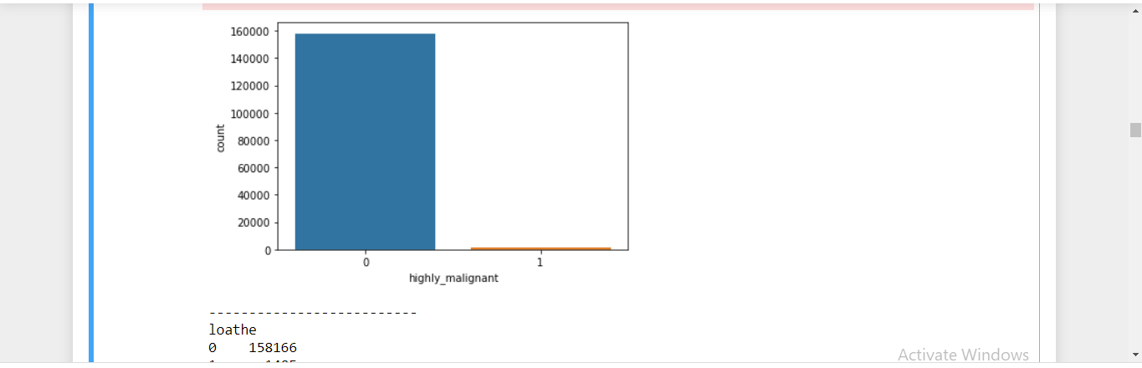
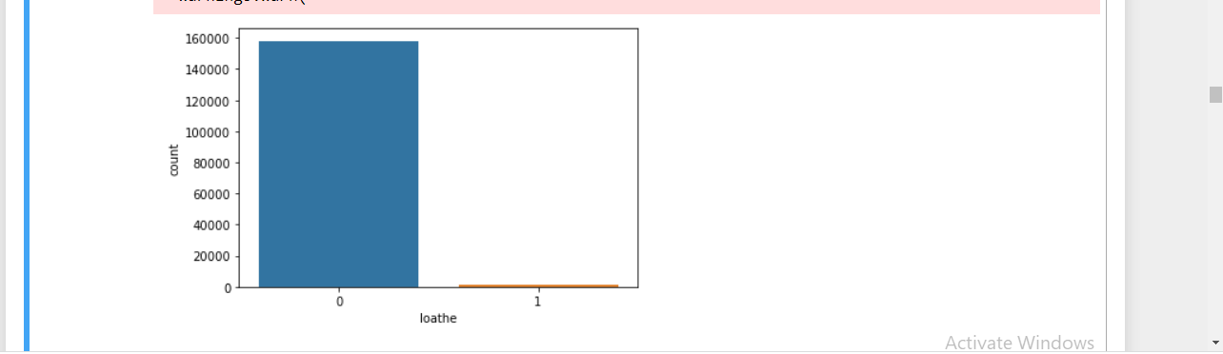

Slide 20
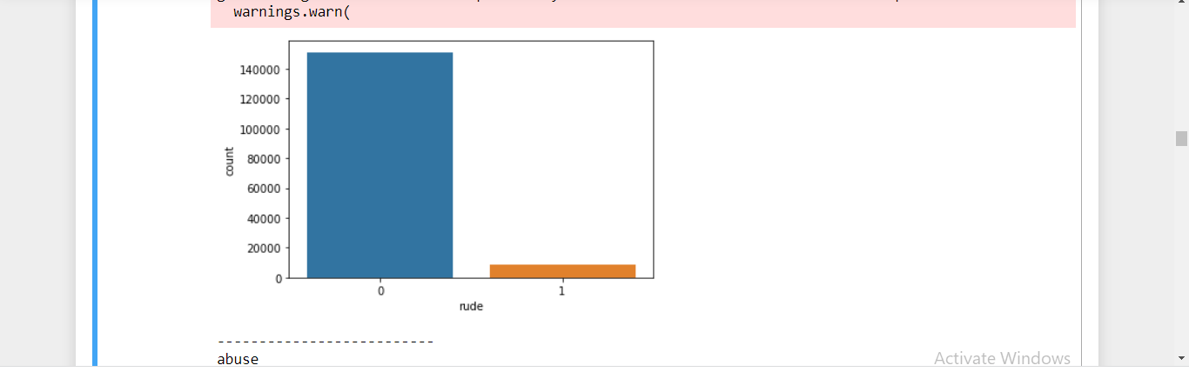
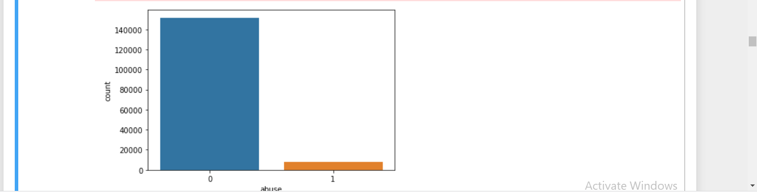

Slide 21
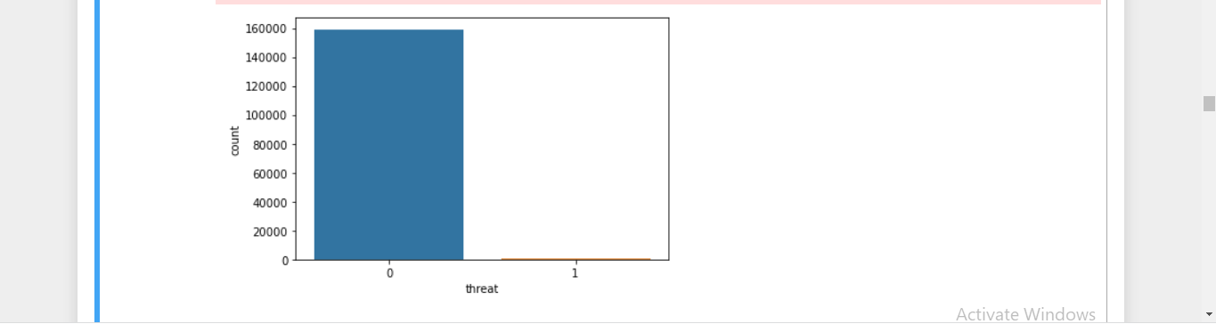
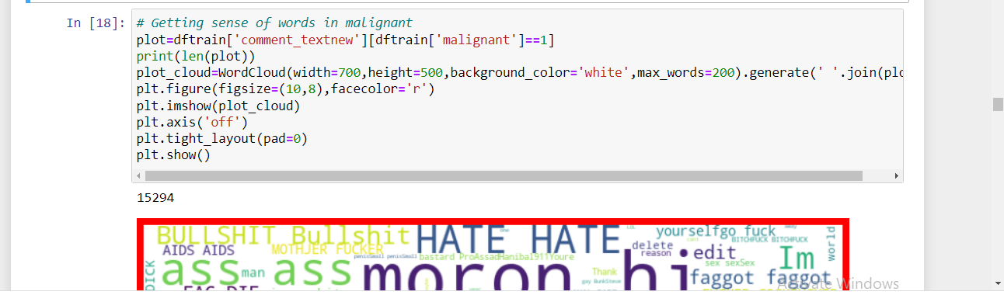

Slide 22
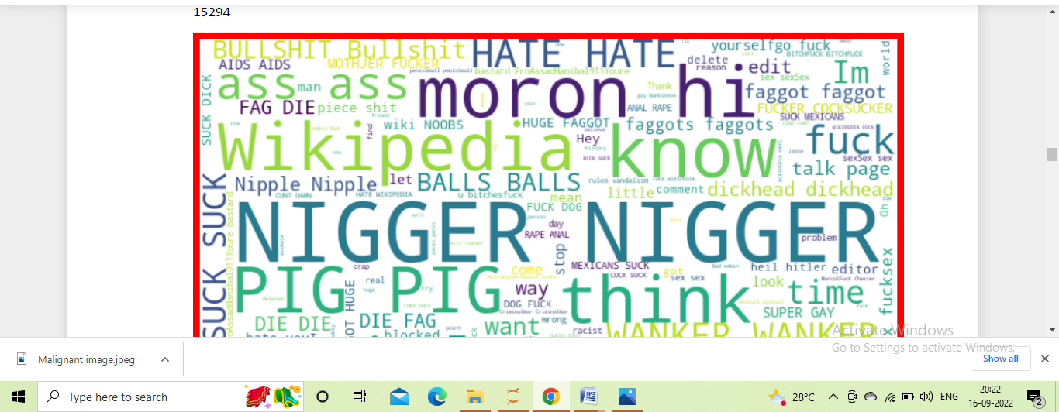
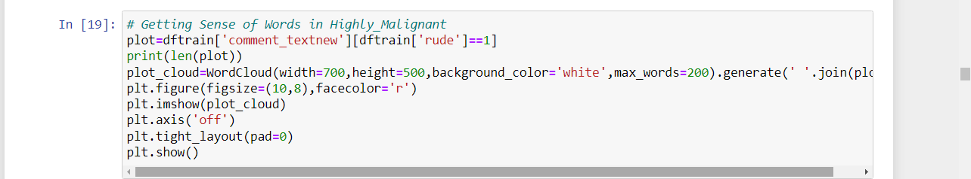

Slide 23
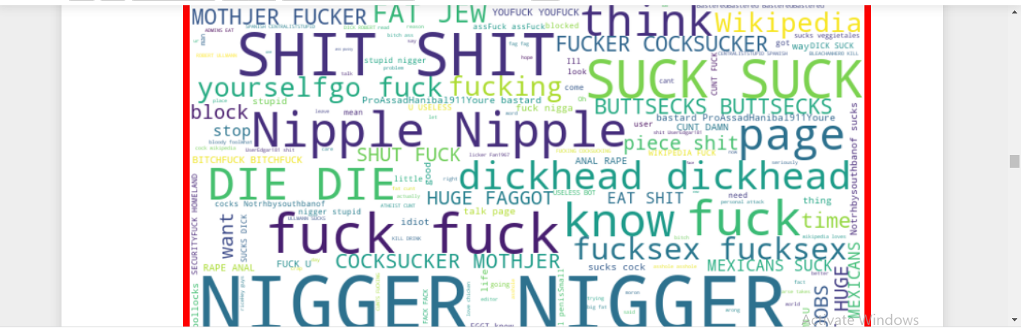
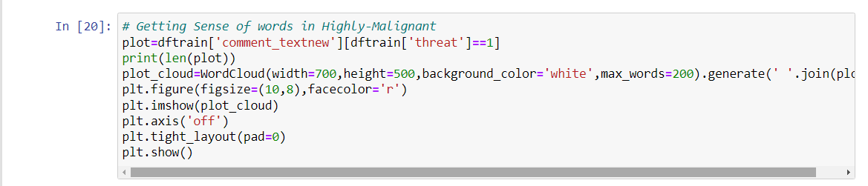

Slide 24
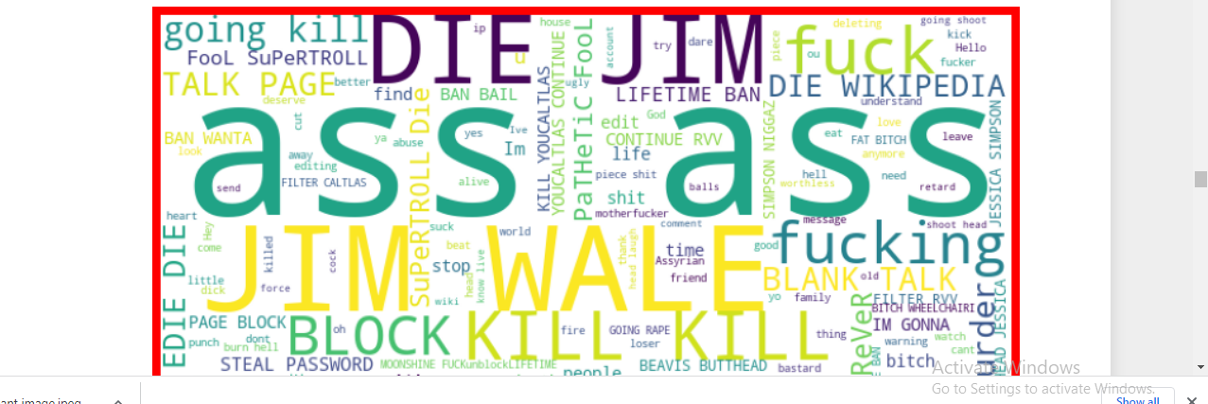
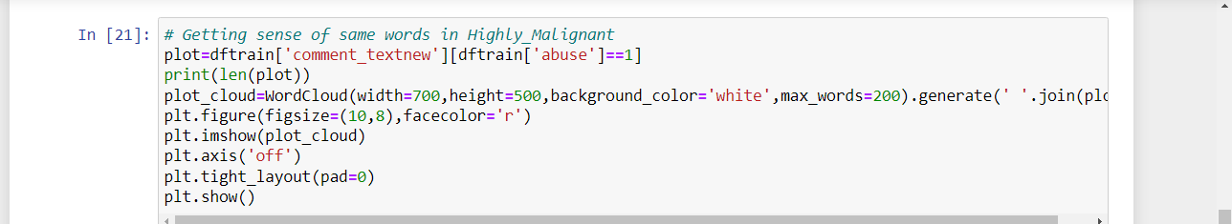

Slide 25
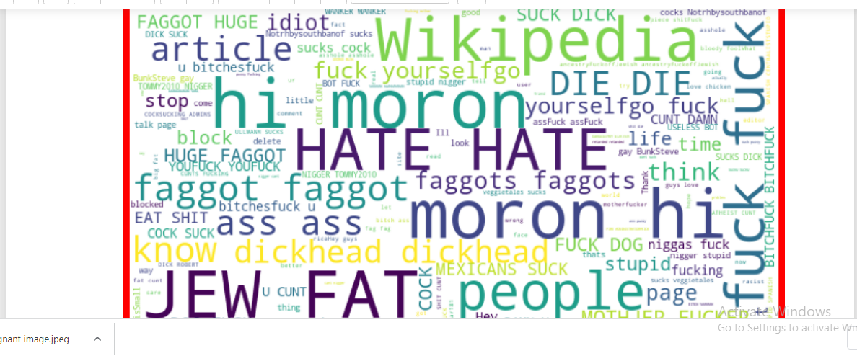
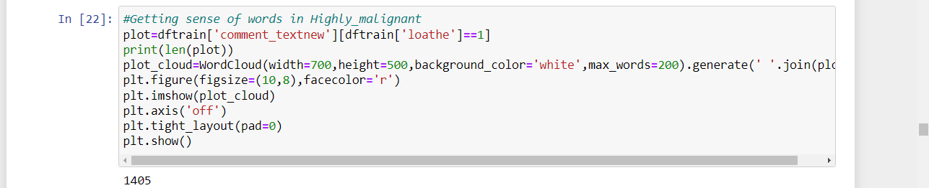

Slide 26
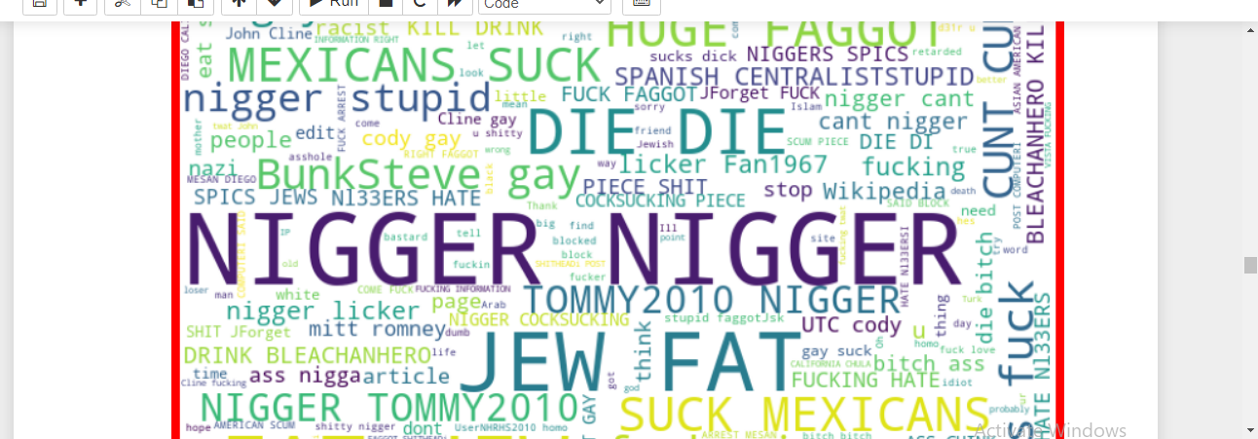
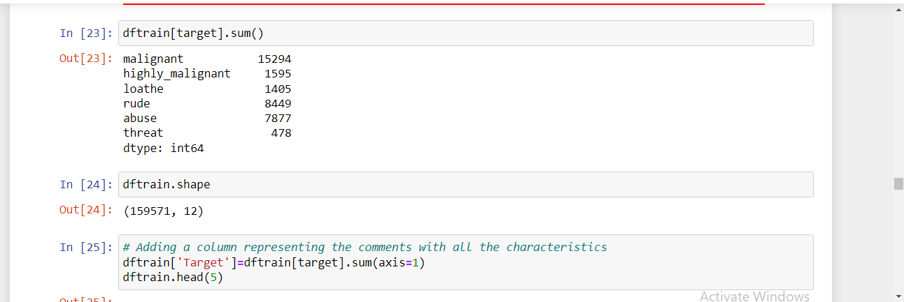

Slide 27
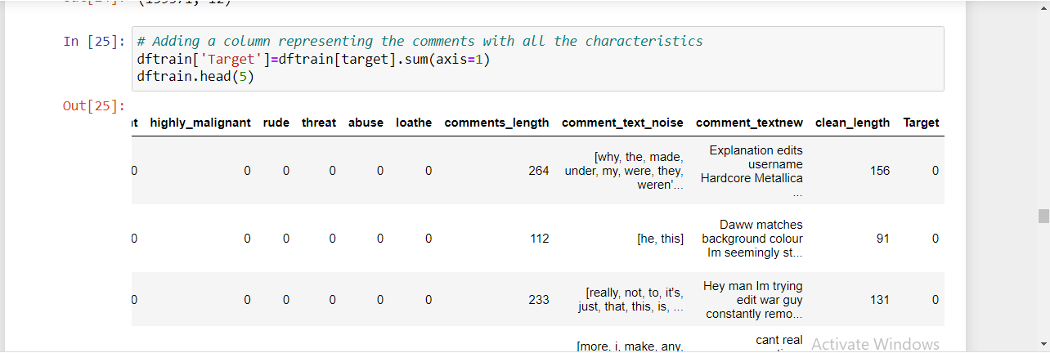
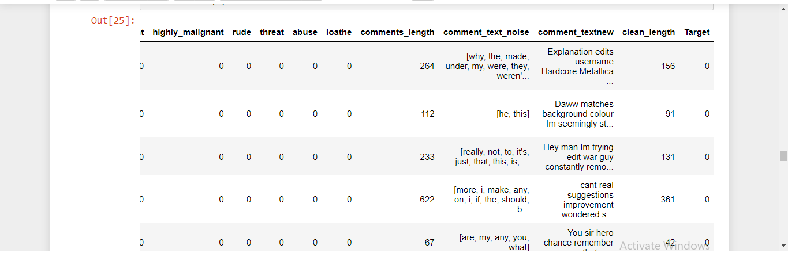

Slide 28
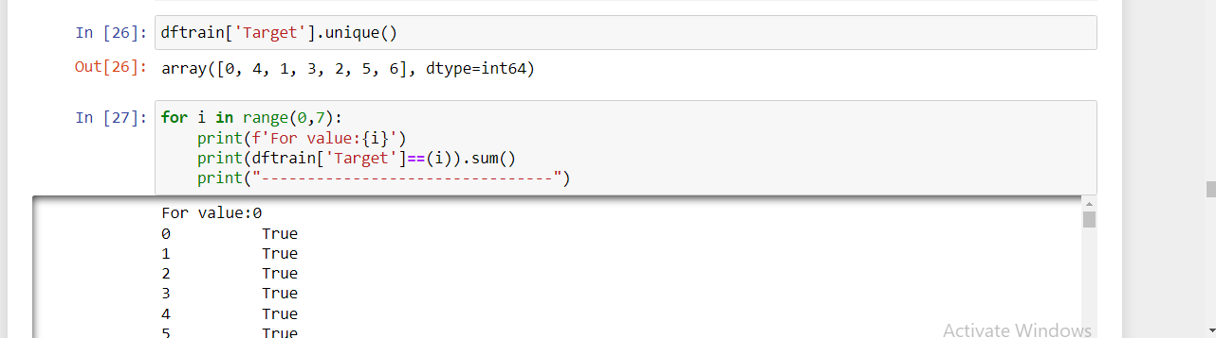
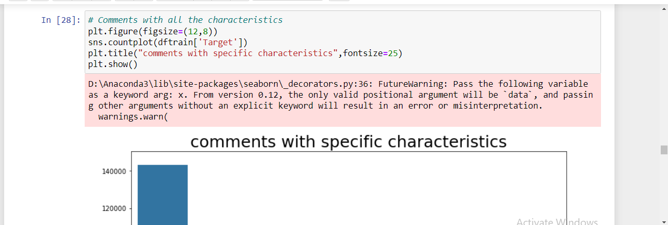

Slide 29
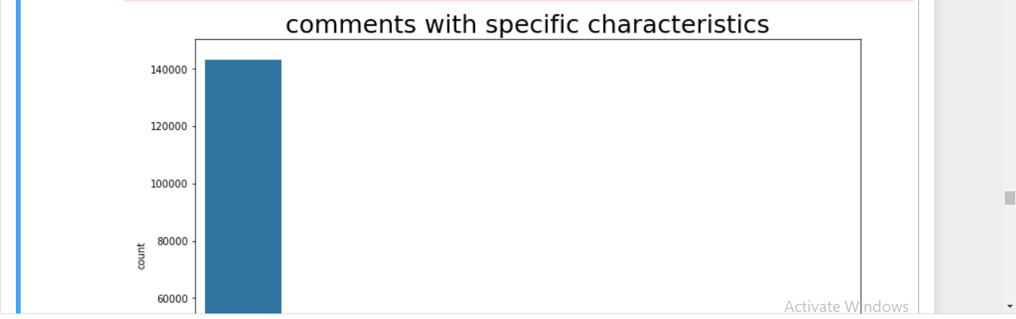
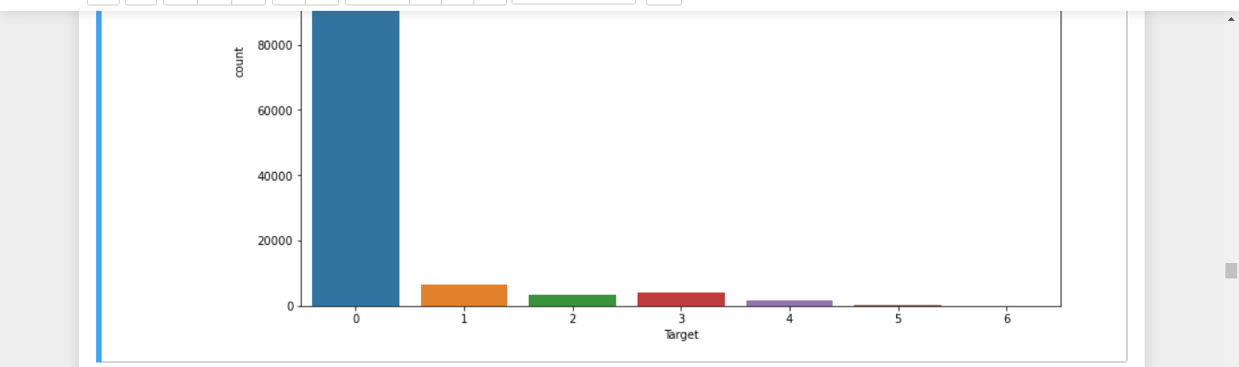

Slide 30
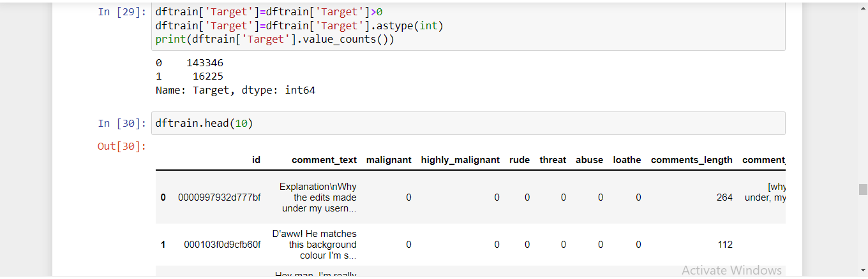
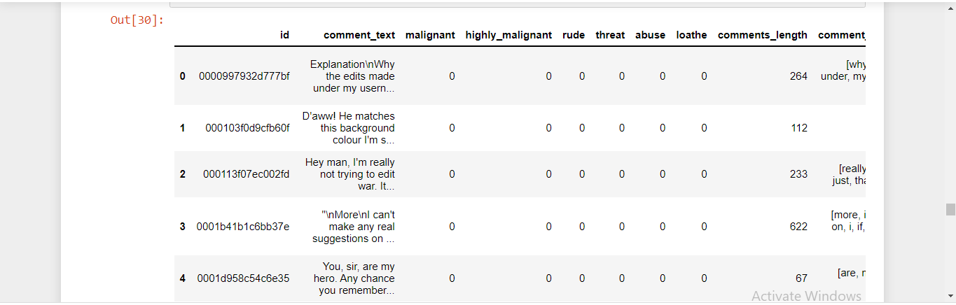

Slide 31
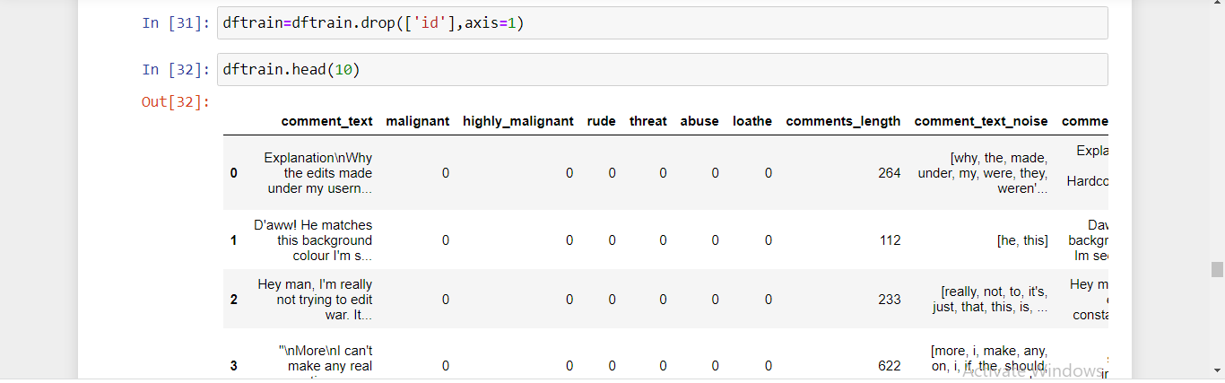
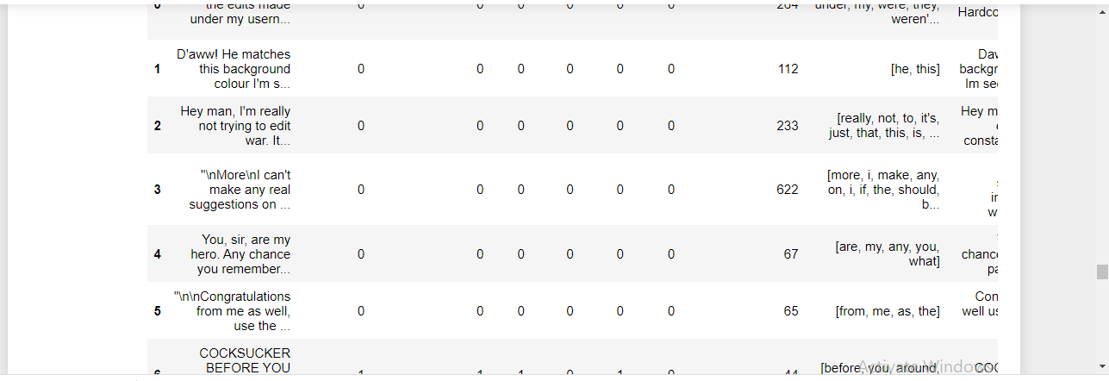

Slide 32
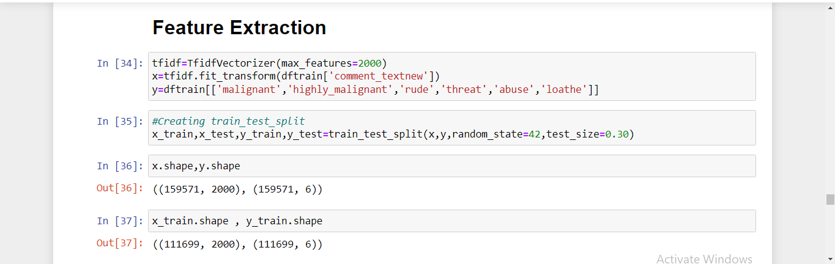
FEATURE EXTRACTION :-

Slide 33
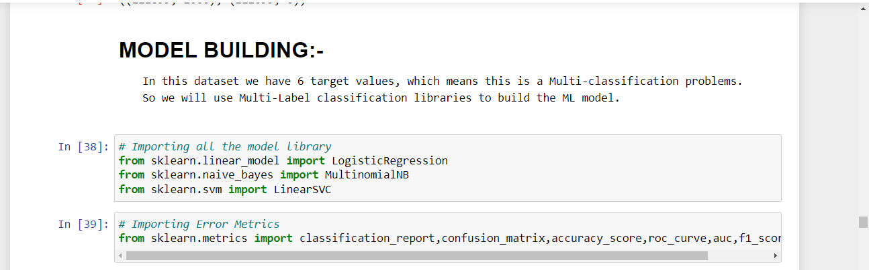
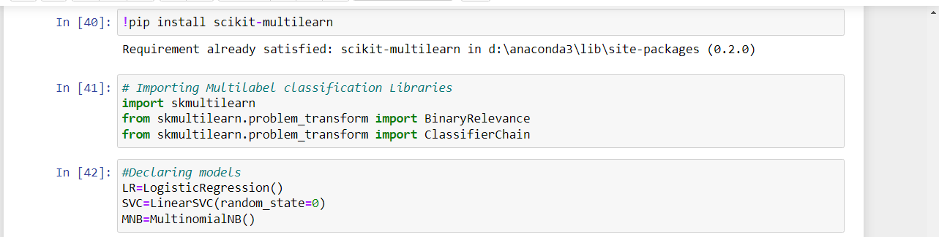
MODEL BUILDING :-

Slide 34
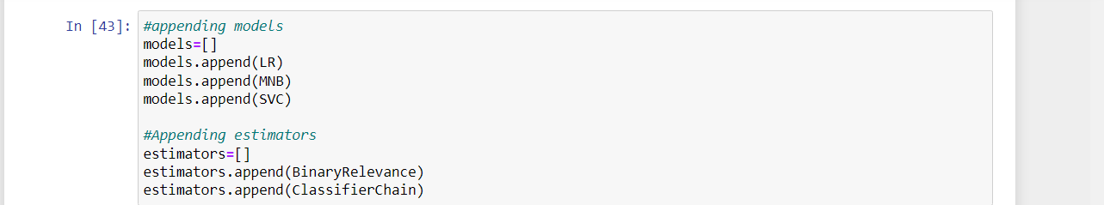
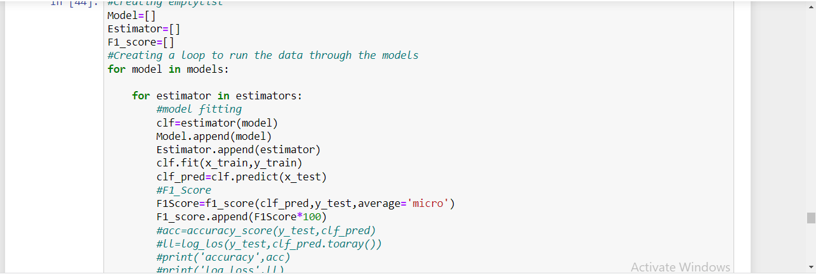

Slide 35
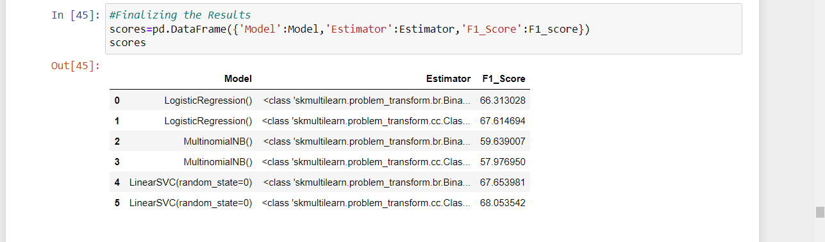
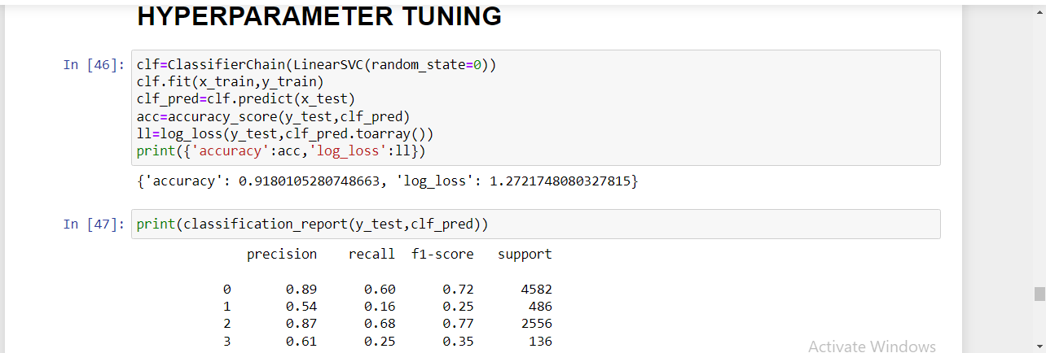
HYPERPARAMETER TUNING :-

Slide 36
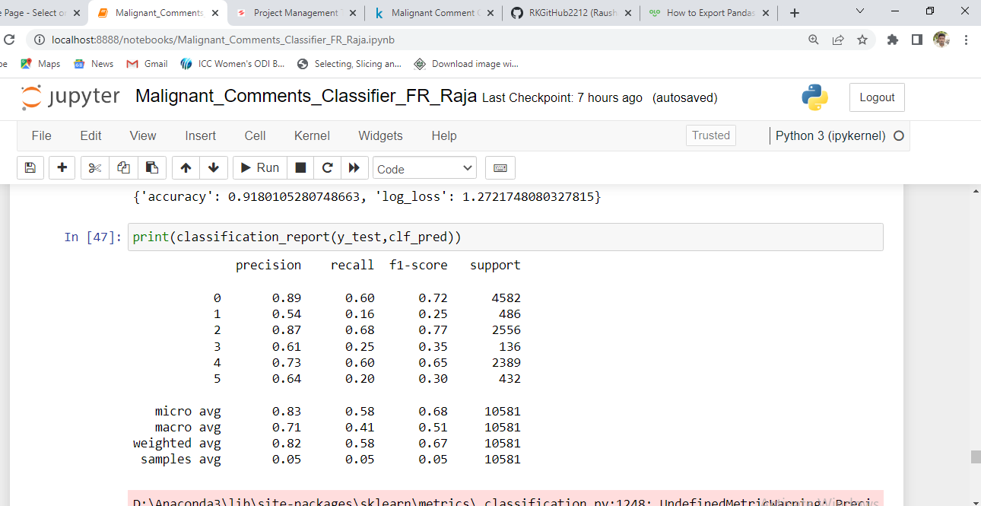

Slide 37
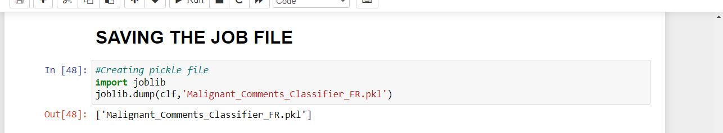

SAVING THE JOB FILE :-
PREDICTIONS ON TEST DATA :-

Slide 38



Slide 39



Slide 40



Slide 41
END

